Slide 1
TECH4ED PROPELS AND ENHANCE COMMUNITY DEVELOPMENT

Slide 2
RIZAL PROVINCIAL LIBRARY
MISSION
Rizal Provincial Library propels lifelong learning by enabling all segments of the Community access to multitudes of learning opportunities.
VISION
Community transformation by delivery of library services relevant to community needs.

Slide 3
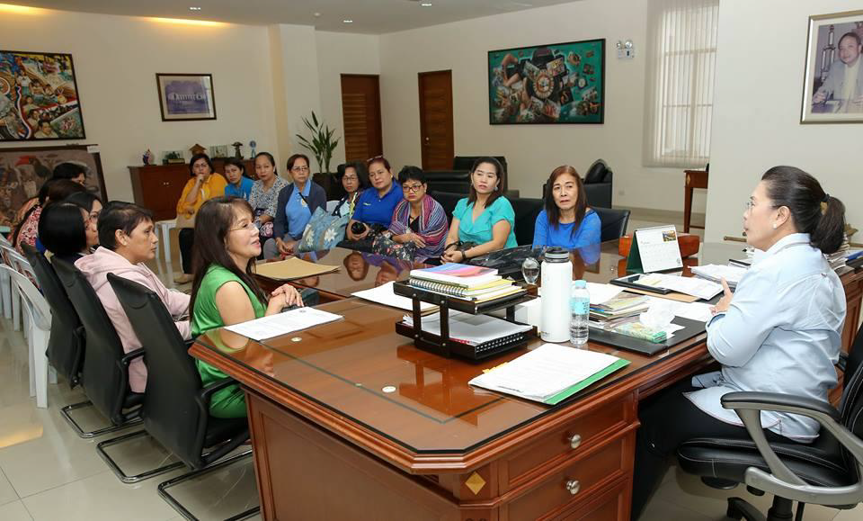
Upon instruction of Gov. Nini Ynares to modernize library operations,
BRAINSTORMING SESSION w/ Rizal Provincial Librarians

Slide 4
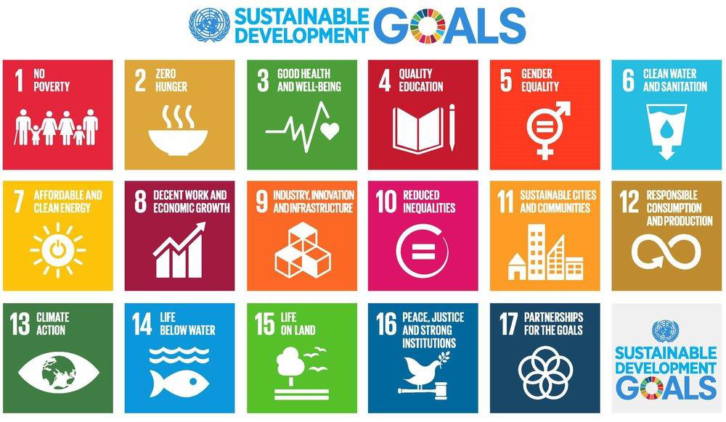
In line with the:

Slide 5
And exemplifying,
GOV. NINI YNARES DEV. PROGRAMS

Slide 6
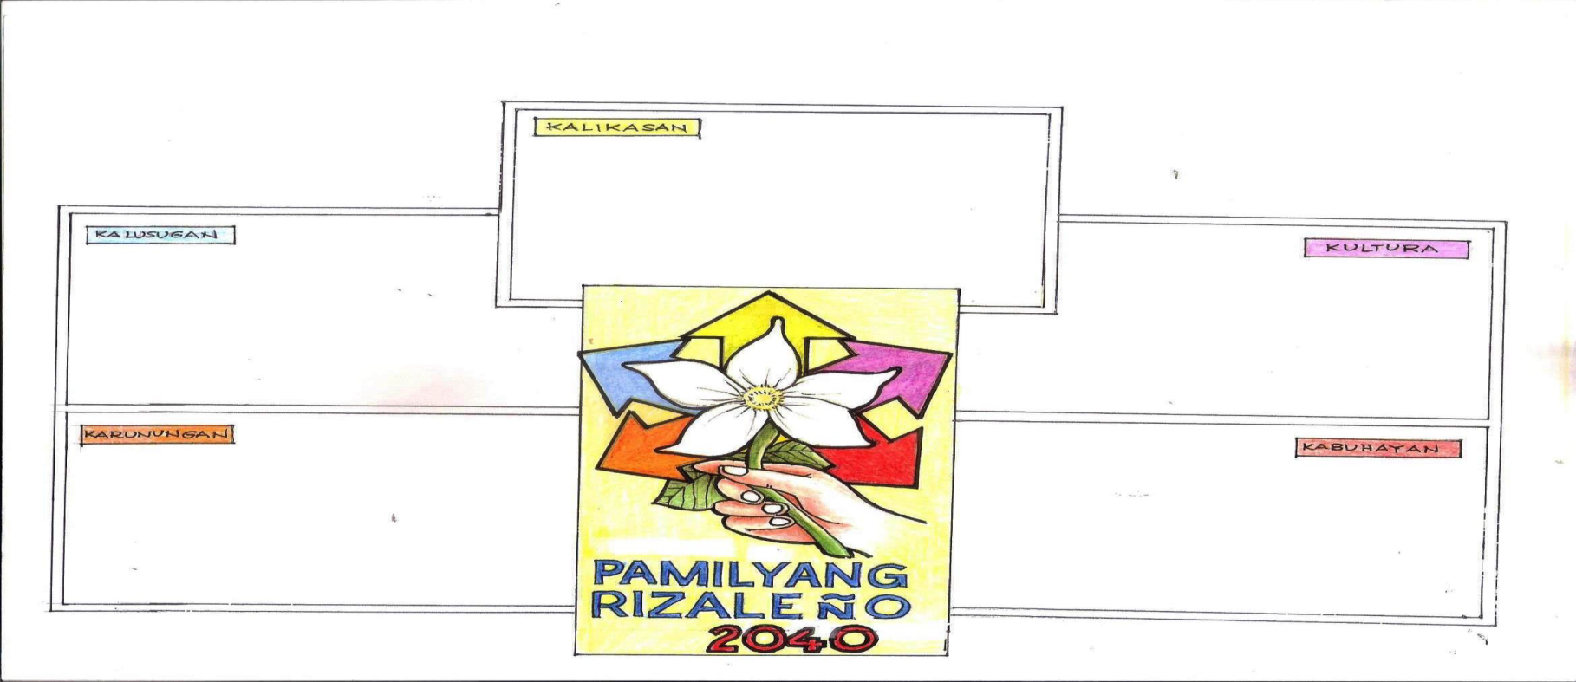
On April 20, 2017 Rizal Provincial Library (RPL) came up with 5 Pillars for innovative library programs based on UK model and adopted the 5K (Kultura, Kalusugan, Karunungan, Kalikasan, at Kabuhayan) under the guidance and supervision of the National Library of the Philippines.
KALIKASAN
KALUSUGAN
KULTURA
KARUNUNGAN
KABUHAYAN
Introduced as framework for modern library operations during the National Convention of Public Librarians in Novotel on March 13-16, 2018.

Slide 7
TO KNOW MORE ABOUT 5K, PLEASE VISIT OUR WEBSITE @ provinciallibrary.rizalprovince.ph

Slide 8
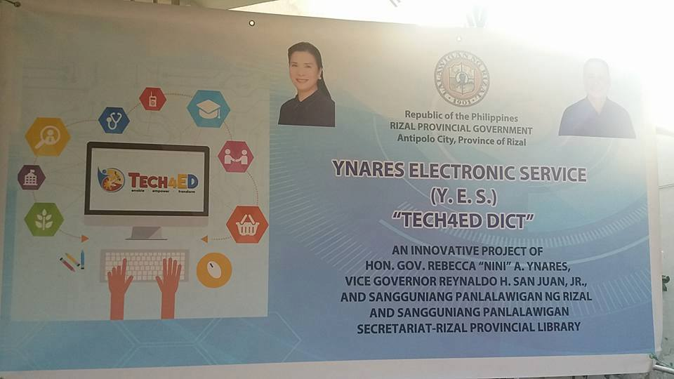
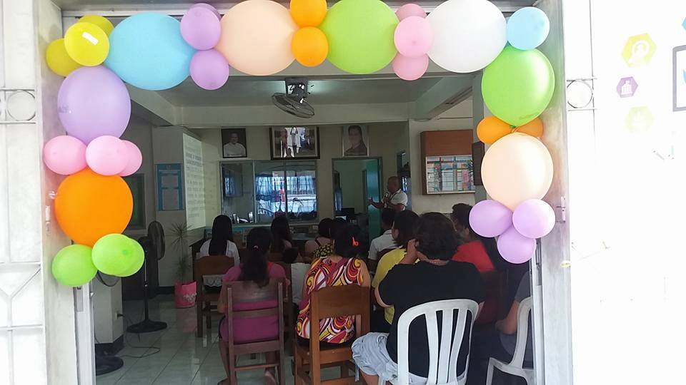
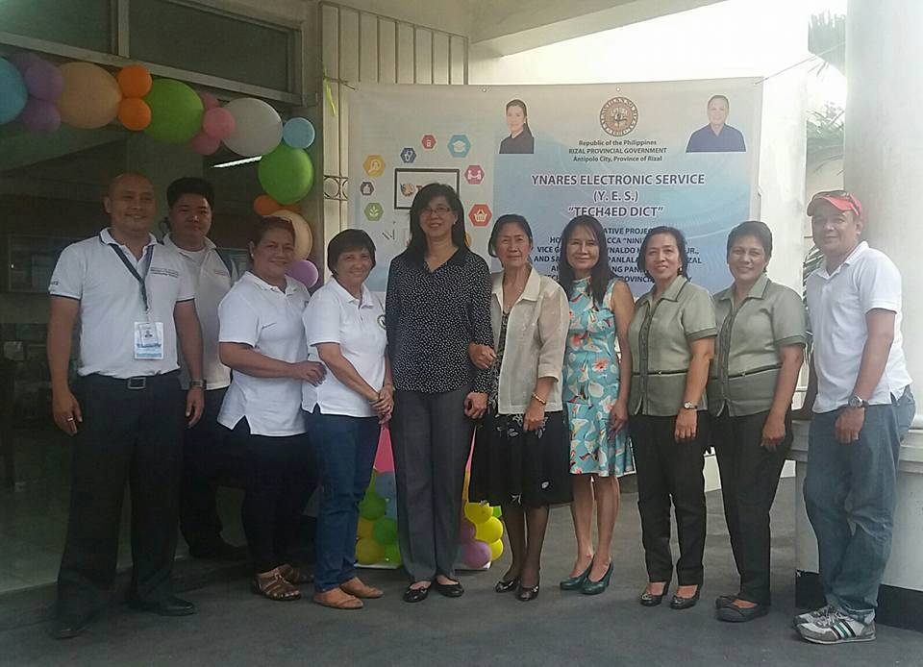
To intensify library modernization The Rizal Provincial Library (RPL) collaborated with Department of Information and Communication Technology (DICT) and established the Tech4Ed Center.

Slide 9
The Province of Rizal is pre dominantly engaged in farming, however farmers are hesitant to employ modern methods of farming and introduction of high-yield variety for the following reasons:
Farmers Children refuse to work on the farm and continue the means of Livelihood their parents have introduce.
Farmers children are opting to work on non farming jobs.
High-yield will mean additional inputs and additional loss during calamity and epidemics.
Crop insurance refuse to award insurance claims for lack of means to report farm loses in time. This runs contrary to the Global, National and Provincial concern for development.
Hence, RPL conceptualized programs on how to educate farmers, first and foremost thru digital literacy, on their sons and daughter or the children of the farmers. And collaborated extensively with Department of Information and Communication Technology (DICT), with the Tech4Ed platform and other programs. Digital Literacy was introduce and conducted in several municipalities and Home Based Online Teaching through 51 Talk was also integrated in the modernization scheme of the library.

Slide 11
WHO IS 51TALK?
51Talk (“five-one talk”) is the largest and leading online English education platform in the world, specializes in providing quality English online training for kids and adults.
51Talk is a leading global online English-education platform. We connect our community of 10,000+ teachers around the world to children eager to learn English through our 1-to-1 online virtual classrooms. 51Talk was established in China in 2011 and since 2012, it has been operating in the Philippines, creating thousands of jobs for home-based teachers.

Slide 12
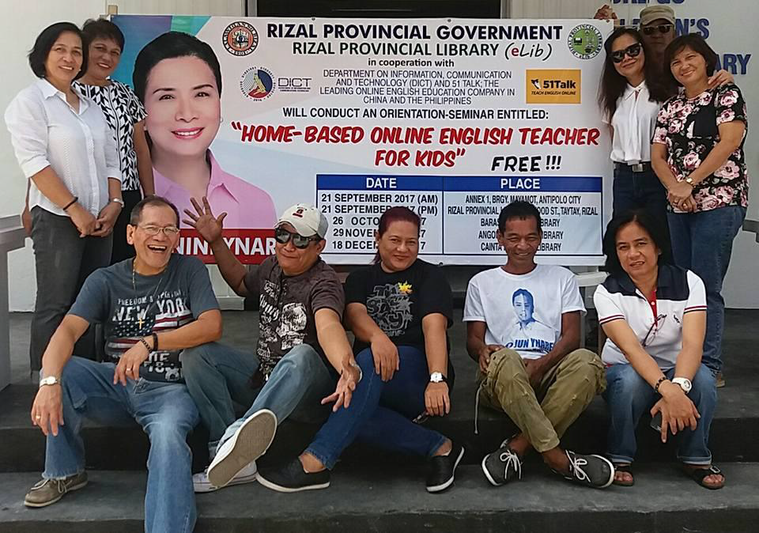
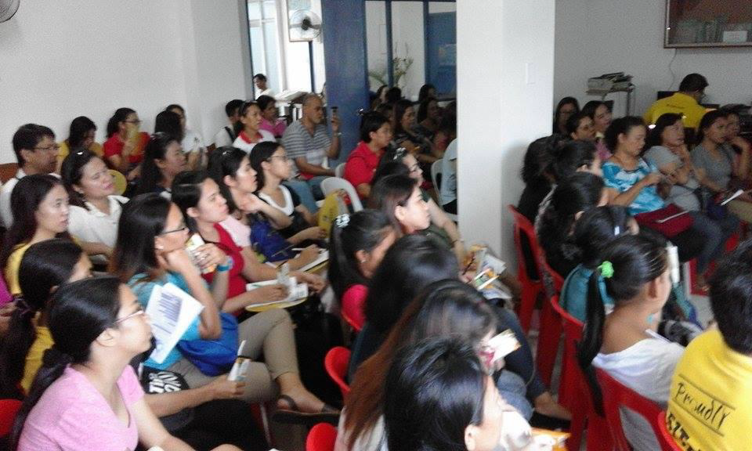
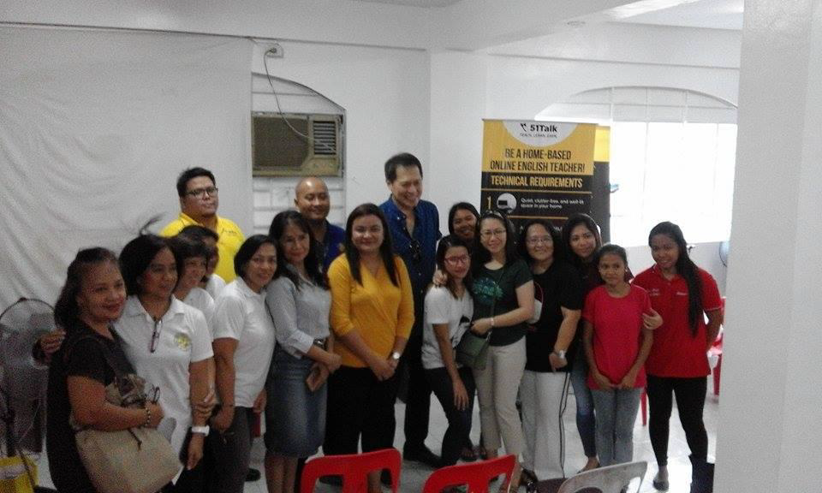
September 21, 2017 Free Seminar/Orientation at the Rizal Provincial Library

Slide 13
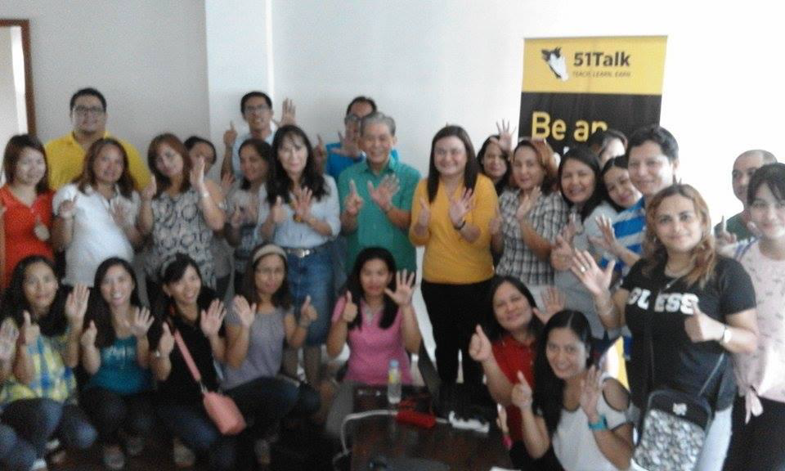
SEPTEMBER 21, 2017 AT ANNEX1 ANTIPOLO, CITY

Slide 14
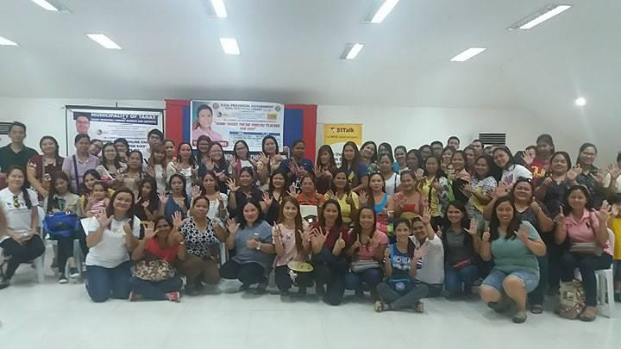
NOVEMBER19, 2017 AT TANAY MUNICIPAL LIBRARY

Slide 15
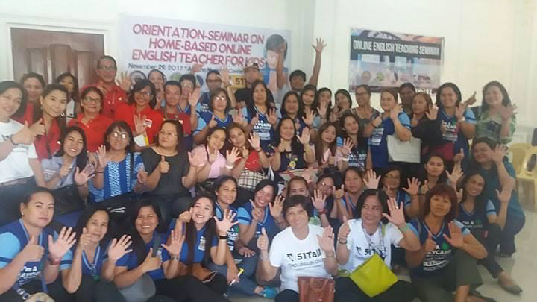
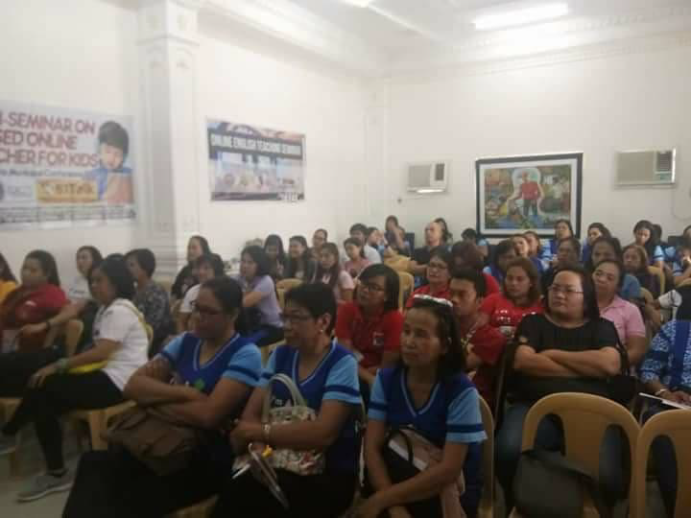
NOVEMBER 29, 2017 AT ANGONO, RIZAL

Slide 16
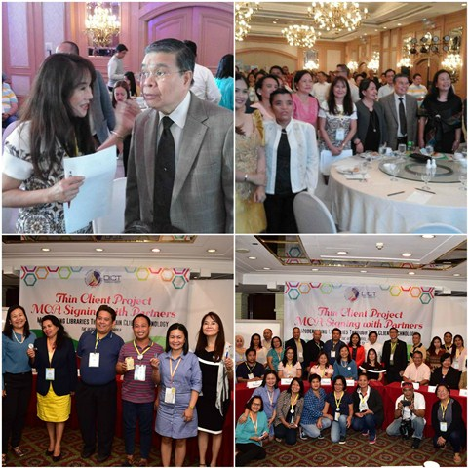
On December 13-15, 2017 during the seminar on KEC 12 ( Knowledge Exchange Conference) Krops was introduced by DICT.

Slide 18
Krops is a platform wherein you can have access to every food source in the world, from the biggest farms to the smallest backyard. The app provides access to supply and demand information to aid farmers in production and assist buyers in purchasing. To the seller, it helps you sell your farm produce at the price you want and to the buyer, it helps you get the lowest price from the farmer. It helps you EARN MORE while you GAIN MORE . KROPS, a 24/7 Online Marketplace to Shop.
RPL invited Mr. Wilson Kenson of DICT, representative of Krops, Ms. Mata of Rizal Provincial Agriculture Office, and Ms. Vaness of 51 Talk, to discuss the product introduction.
RPL asked Ms. Mata if she agree with the concept of introducing the project to the farmers and their children.
Ms. Mata confirmed and said she is very much agreeable to the project and welcomes it very much.

Slide 19
The Product Introduction was done at Teresa, Rizal. Present were the Department of Agriculture representative from the Regional Office, SB members, Municipal Agriculture. The product initially discussed for Krops was rice. The concept of improved variety of rice being introduced to the farmers were given consideration . Some farmers are adamant to plant high yielding variety now that to farmers thought that:
More yield will give them more problem on marketing
More capital will expose them to high risk and high percentage of loss.
Crop insurance will not be an answer but a false hope when calamity strikes for lack of immediate and acceptable means for reporting damage to crops

Slide 20
Livelihood Marketing with Krops has effect on Economic Development.
Less Production – Farmers hesitant to produce
No famers (youngsters reject farming
High yield products
More investment needs bigger capital. At the start it should be free.
Likewise, the Krops program was introduced to other municipalites;

Slide 21
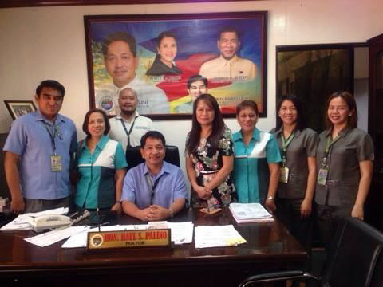
Teresa Rizal on July 20, 2017

Slide 22
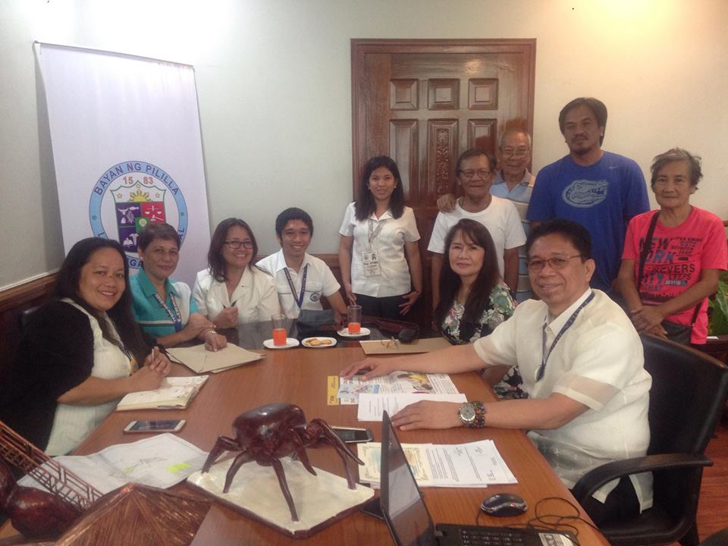
Pililla, Rizal on August 24, 2017

Slide 23
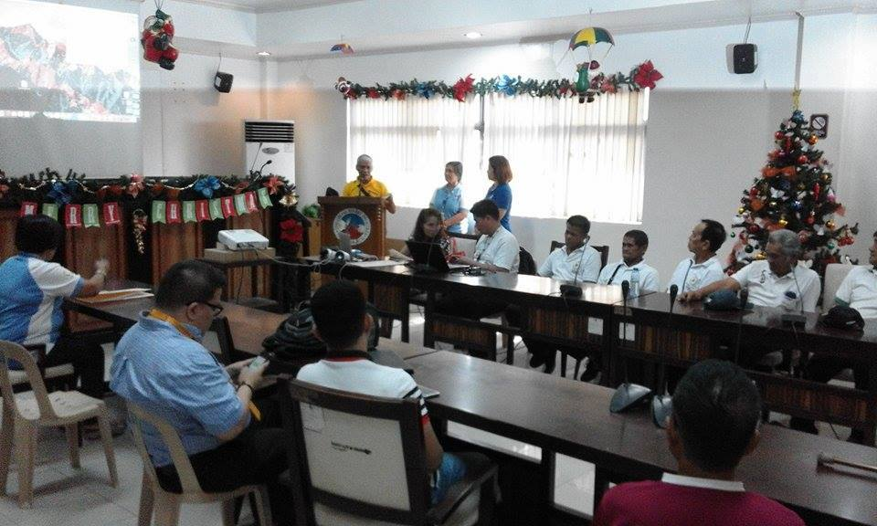
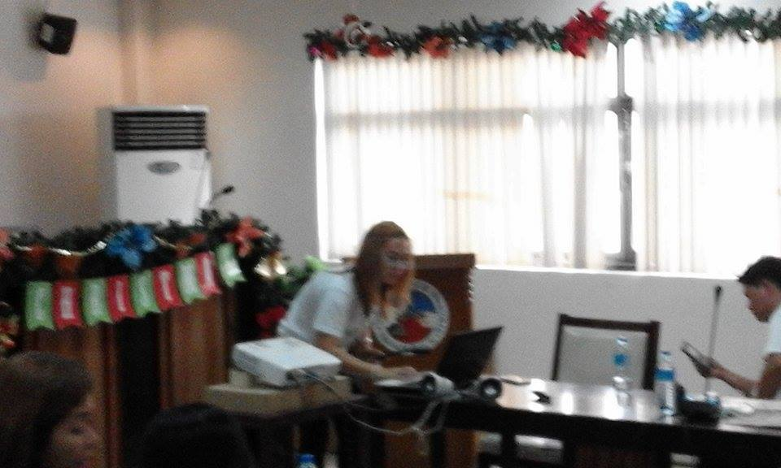
Binangonan, Rizal on November 23, 2017

Slide 24
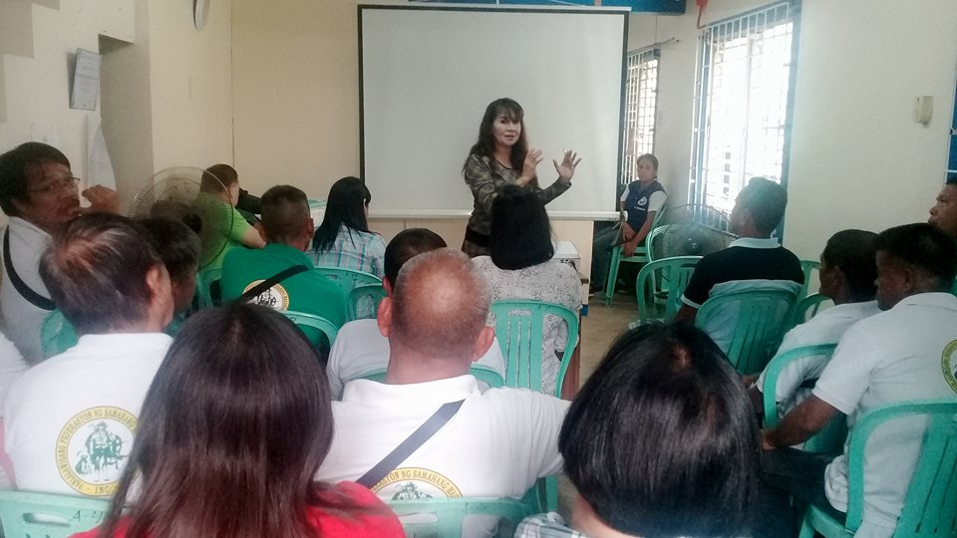
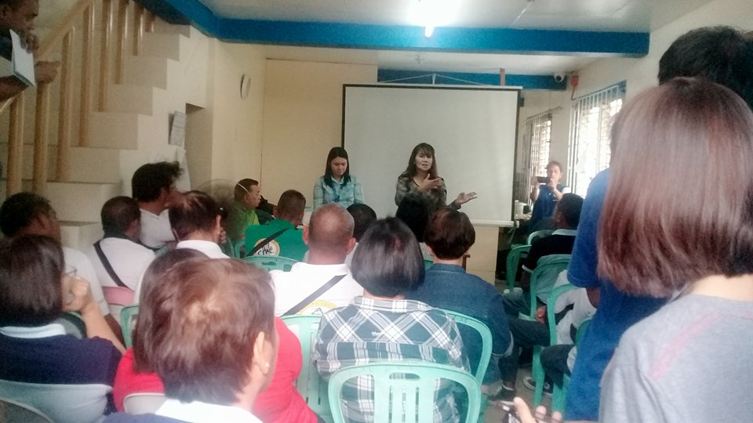
San Mateo, Rizal on January 25, 2018

Slide 25
Good results:
What are the effects on the life of;
Farmers
Farmer’s wife
Farmer’s children brought about by the Krops program and 51 talk seminars?
Kindly access our success stories on our
Youtube account: provinciallibrary_rizal@yahoo.com
Facebook account: provinciallibrary_rizal@yahoo.com
and URL Website:
provinciallibrary.rizalprovince.ph

Slide 27
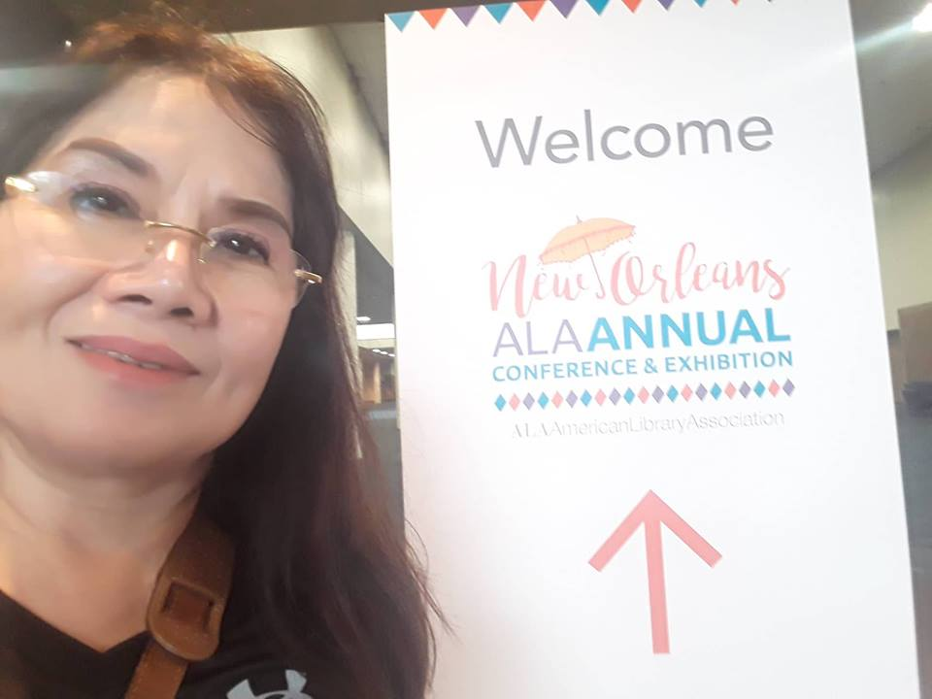

Slide 28
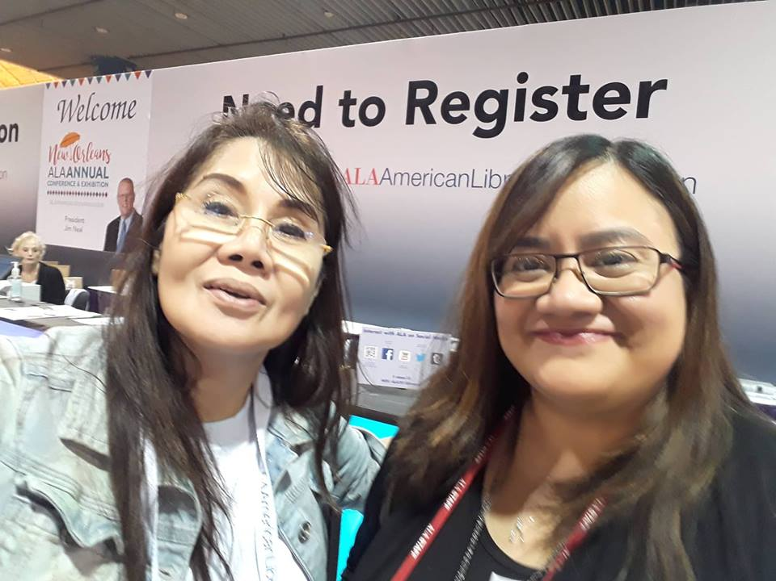
With Delin R. Guerra
International Relations Office
ALA American Library Association
(Asociación de Bibliotecas de los Estados Unidos-ALA)
dguerra@ala.org

Slide 29
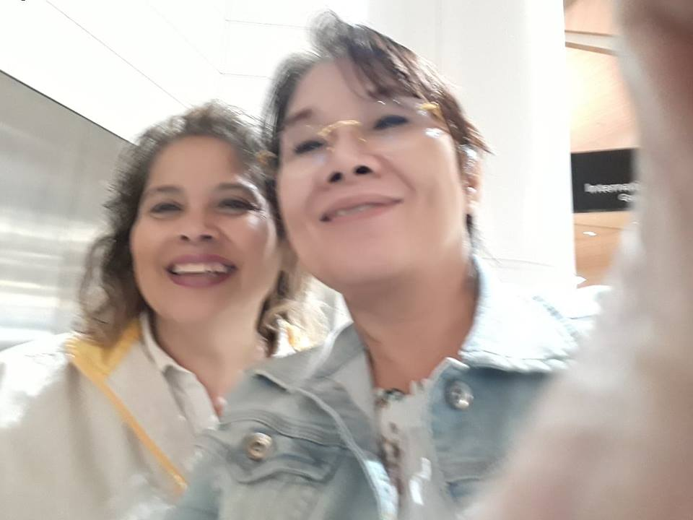
With Samantha Oakley
Program Officer
Public Programs Office
ALAAmericanLibraryAssociation
(312) 280-5287
www.ala.org/publicprograms
www.ProgrammingLibrarian.org

Slide 30
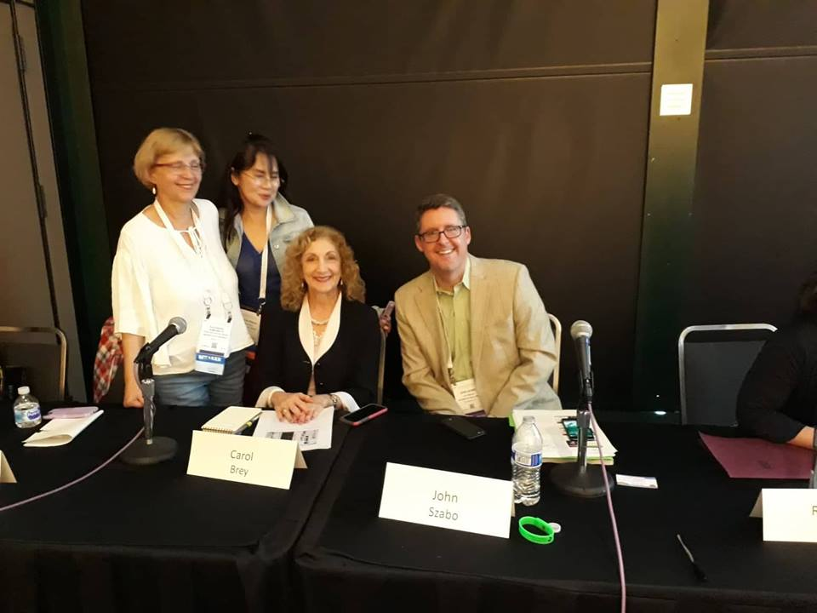
With Chairman ,Alexandra Houzouri Humphreys,
Vice Chair, C. Angela Wiehagen
and City Librarian of Los Angeles Public Library, John P. Szabo

Slide 31
Rizal Provincial Library received Credit!
Success!
Your Badge has been added to your profile. Time to share it with the world!
Badge Details
Title
Introduction to Dialogue & Deliberation for Small, Mid-sized or Rural Public Libraries (2018 Libraries Transforming Communities)
Description
Recipients of this badge completed Part 1 of the Libraries Transforming Communities: Models for Change three-part webinar series on dialogue and deliberation models for public libraries serving small, mid-sized and/or rural communities.

Slide 32
Rizal Provincial Library received Credit!
Success!
Your Badge has been added to your profile. Time to share it with the world!
Badge Details
Title
Future Search (2018 Libraries Transforming Communities)
Description
Recipients of this badge completed Part 2 of the Libraries Transforming Communities: Models for Change three-part webinar series on dialogue and deliberation models for public libraries serving small, mid-sized and/or rural communities.

Slide 33
Rizal Provincial Library received Credit!
Success!
Your Badge has been added to your profile. Time to share it with the world!
Badge Details
Title
Everyday Democracy's Dialogue to Change Process (2017 Libraries Transforming Communities)
Description
Recipients of this badge completed Part 3 of the Libraries Transforming Communities: Models for Change three-part webinar series on dialogue and deliberation models for public libraries serving larger and/or urban communities.

Slide 34
To know more about the webinars with emphasis on how to initiate a large-scale program to bring together groups of people from different backgrounds and viewpoints to talk about an issue. Here, participants will learn how to utilize Everyday Democracy's Dialogue to Change process, which leads to a wide range of action and change efforts.
Please visit The Rizal Provincial Library and open Credly Account, this is our direct account with the American Library Association (ALA).

Slide 35
THANK YOU!!!

